Slide 1
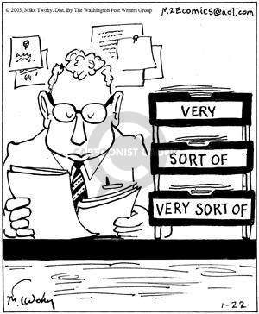
CSE 445: Machine Learning
Classification
Instructor: Syed Athar Bin Amir, North South University

Slide 2
Supervised Learning
Regression → involves predicting values (continuous)
Classification → predicting classes (discrete)
REGRESSION
Predicting Final Marks
Student Profile
CLASSIFICATION
Predicting Pass/Fail/Grade

Slide 3
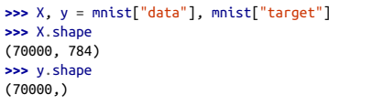
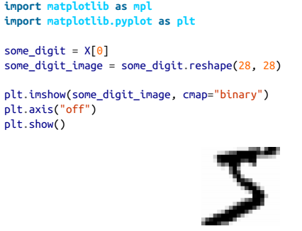
MNIST
70,000 small images of handwritten images
The “Hello, World” of Machine Learning
Each image has 28 x 28 pixels, which comes out to 784 features
Each feature represents a pixel’s intensity from 0 to 255
Comes pre-shuffled, with the first 60,000 images for training, and the remaining 10,000 images for testing

Slide 4
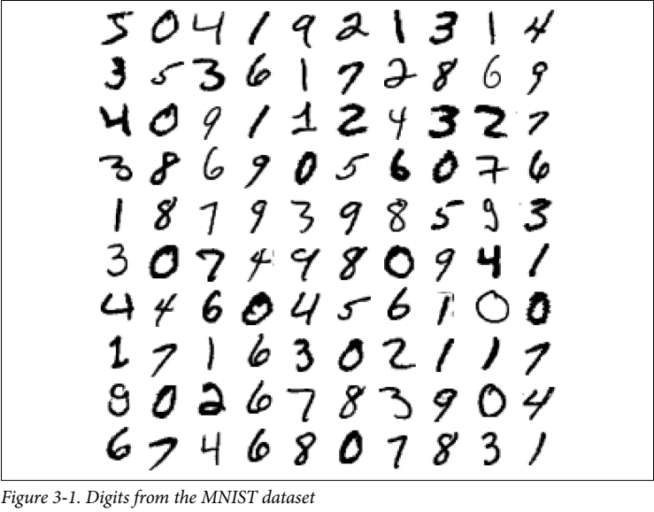
Digits from MNIST dataset

Slide 5
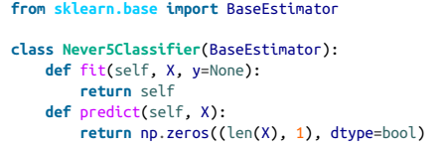
Classification Performance Measure
Classification often deals with skewed datasets
Accuracy is not the preferred performance measure!
e.g. even an untrained binary classifier can have 90% accuracy if one of the classes constitute just 10% of images!

Slide 6
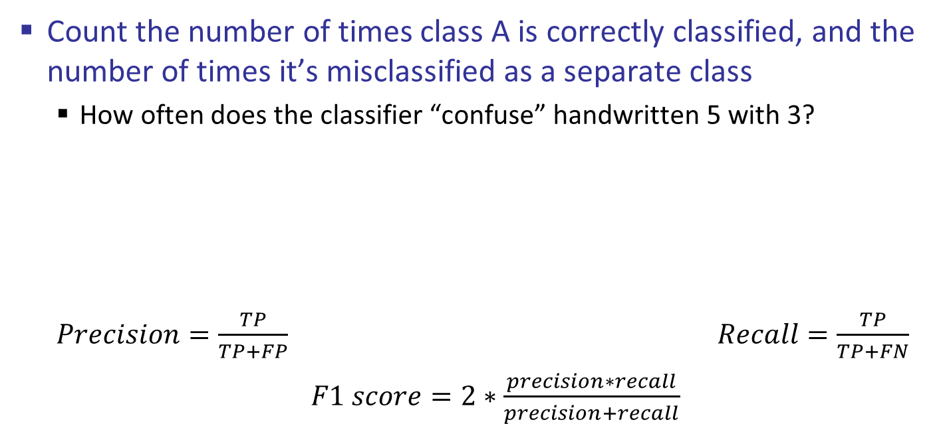
Confusion Matrix
Count the number of times class A is correctly classified, and the number of times it’s misclassified as a separate class
How often does the classifier “confuse” handwritten 5 with 3?
$Precision=\frac{TP}{TP+FP}$ $Recall=\frac{TP}{TP+FN}$
$F1 score=2∗\frac{precision∗recall}{precision+recall}$
Predicted Actual | Not 5 | 5
Not 5 | 53057 (True Negative) | 1522 (False Positive)
5 | 1325 (False Negative) | 4096 (True Positive)

Slide 7
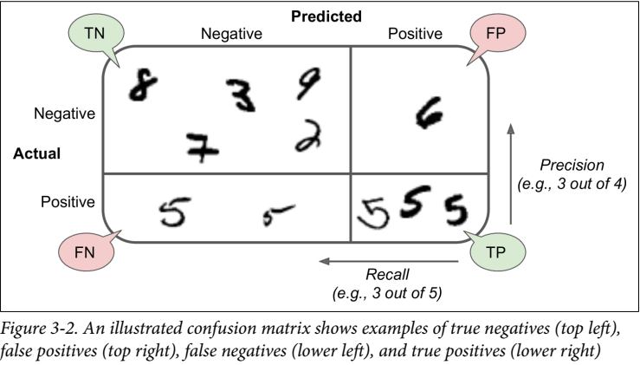
Confusion Matrix

Slide 8
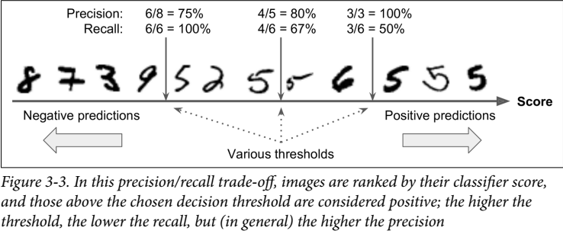
Precision/Recall Tradeoff
Increasing classifier precision leads to lower recall, and vice versa!

Slide 9
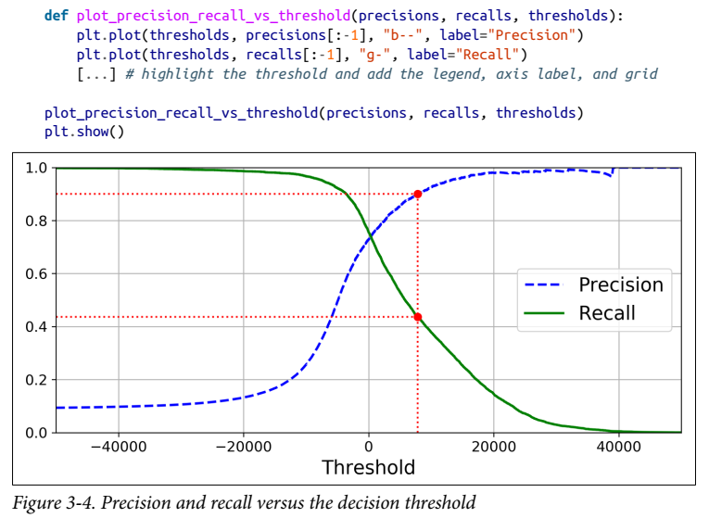
Precision/Recall Curve
Fairly easy to create a classifier with high precision – but at what recall?

Slide 10
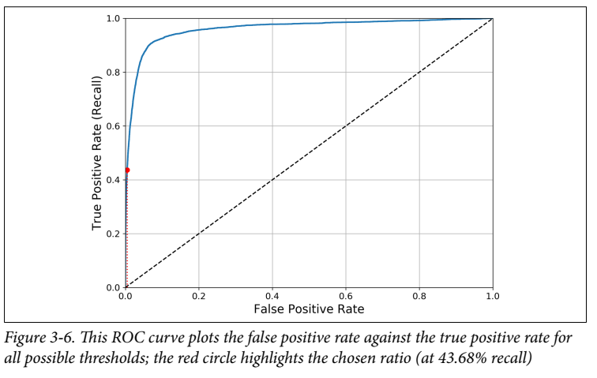
Receiver Operating Characteristic (ROC) curve
Plots:
True Positive Rate (TPR → another name for Recall/Sensitivity) against
False Positive Rate (FPR → Ratio of negative instances that are incorrectly classified as positive)
FPR = 1 – TNR = 1 – Specificity
ROC curve plots sensitivity (recall) against (1- specificity)

Slide 11

Receiver Operating Characteristic (ROC) curve
Higher recall/TPR leads to more false positives
A good classifier stays very close to the top left corner
High TPR, and low FPR
AUC – Area under the curve
Perfect classifier will have an AUC equal to 1
Purely random classifier (dotted diagonal line) will have an AUC equal to 0.5
Use PR curve when positive class is rare in dataset, or when false positives are a greater concern than false negatives

Slide 12
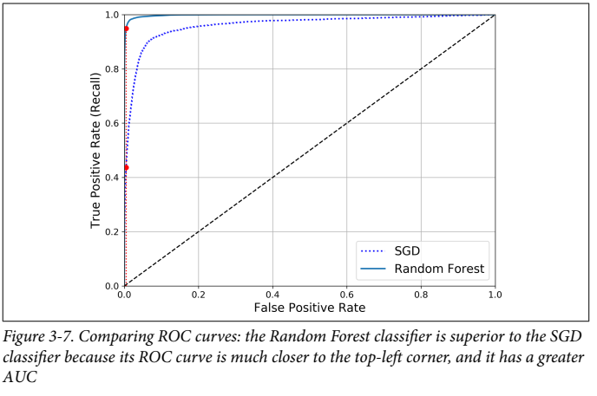
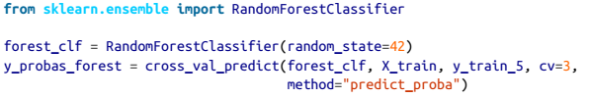


Random Forest Classifier
Ensemble classification with multiple decision trees
Better than SGD Classifier as evident in ROC curve
99% precision and 86.6% recall makes this a better classifier in those regards as well

Slide 13
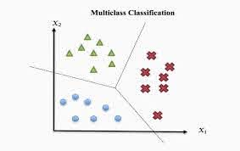
Multiclass Classification
Binary classification – distinguish between two classes
“5” vs “Not 5”
Multiclass classification (also known as multinomial classification) – distinguish between many classes
Some classifiers can handle multiple classes by default
e.g. SGD, Random Forest, Naïve Bayes
Others (like Logistic Regression or SVM) are strictly binary classifiers – however, they can be used for multiclass classification in certain strategies
One-versus-the-rest/One-vs-all (OVR) – one classifier for each class, highest score classifier taken
One-vs-one (OvO) – one classifier for each class pair, N(N-1)/2 classifiers to train if there are N classes

Slide 14
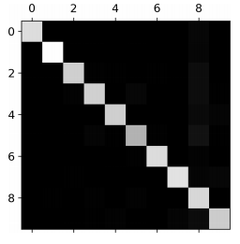
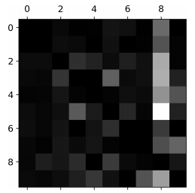
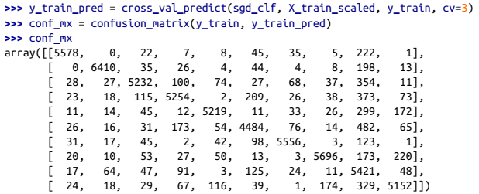
Error Analysis
Look at confusion matrix – easier to understand as image
Bright diagonal indicates most images were correctly classified
Many images misclassified as 8 (bright column) – but images with 8 are correctly classified (dark row)

Slide 15
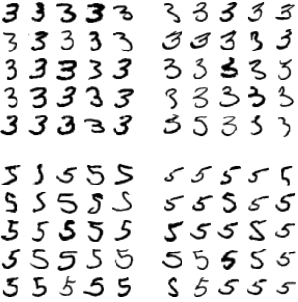
3 or 5?
Bottom-left block are 5s that are incorrectly classified as 3
Top-right block are 3s incorrectly classified as 5
What are the issues with the classifier, and why does it struggle to classify these two classes?

Slide 16

Multilabel Classification
Classification system outputting multiple binary tags
Measure F1 score for each label, and take average across all labels
Can weight the labels according to their support – i.e. how many instances of that label are there?

Slide 17
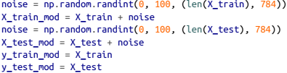
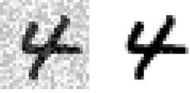
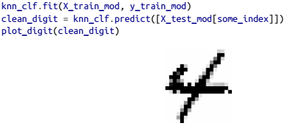
Multioutput Classification
Each label can be multiclass (i.e. have more than two possible values)
Input → noisy digit image (array of pixel intensities)
Output → clean digit image (array of pixel intensities)
One label per pixel, and each label can have multiple values
Note: very similar to a regression problem – predicting pixel intensity is more akin to regression

